Slide 1

COMS W4111 - Introduction to Databases
(Module II)
Lecture 10: NoSQL, CAP, Graph DB, Redis, Document DB
Donald F. Ferguson (dff@cs.columbia.edu)
Lecture 10: NoSQL, CAP, Graph DB, Redis, Document DB

Slide 2

We will start in a few minutes.
2 | Introduction to Databases (F20): Lecture 10: NoSQL, CAP, Graph DB, Redis, Document DB

Slide 3
CAP Theorem and Consistency
3 | Introduction to Databases (F20): Lecture 10: NoSQL, CAP, Graph DB, Redis, Document DB

Slide 4
ACID

Slide 5
CAP Theorem
Consistency
Every read receives the most recent write or an error.
Availability
Every request receives a (non-error) response – without guarantee that it contains the most recent write.
Partition Tolerance
The system continues to operate despite an arbitrary number of messages being dropped (or delayed) by the network between nodes

Slide 6
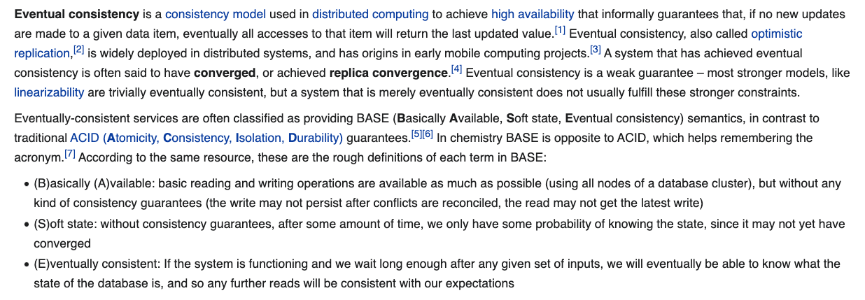
Eventual Consistency
The preceding two slides were simplistic overviews of some of the concepts.
If the DB tolerates network partitions, the DB must either: return error or potentially out of date values.
Achieving availability → you must have multiple copies of the data.
Consistency requires some form of distributed synchronization for updates → cannot tolerate partitions.
Availability and partition tolerance → cannot synchronize updates.
For a lot of applications,
You do not need ACID properties
You cannot achieve the massive, required scale and achieve ACID properties.
All of this is an overly simplistic explanation of some pretty complex concepts and alternatives.
6 | E6156 – Cloud Computing: Backend-as-a-Service: Lecture 8 © Donald Ferguson, 2020

Slide 7
Consistency Models
STRONG CONSISTENCY: Strong consistency is a consistency model where all subsequent accesses to a distributed system will always return the updated value after the update.
WEAK CONSISTENCY: It is a consistency model used in distributed computing where subsequent accesses might not always be returning the updated value. There might be inconsistent responses.
EVENTUAL CONSISTENCY: Eventual consistency is a special type of weak consistency method which informally guarantees that, if no new updates are made to a given data item, eventually all accesses to that item will return the last updated value.

Slide 8
Eventual Consistency
Availability and scalability via
Multiple, replicated data stores.
Read goes to “any” replica.
PUT/POST/DELETE
Goes to any replica
Change propagate asynchronously
GET may not see the latest value if the update has not propagated to the replica.
There are several algorithms for conflict resolution
Detect and handle in application.
Clock/change vectors/version numbers
… …
get
put

Slide 9
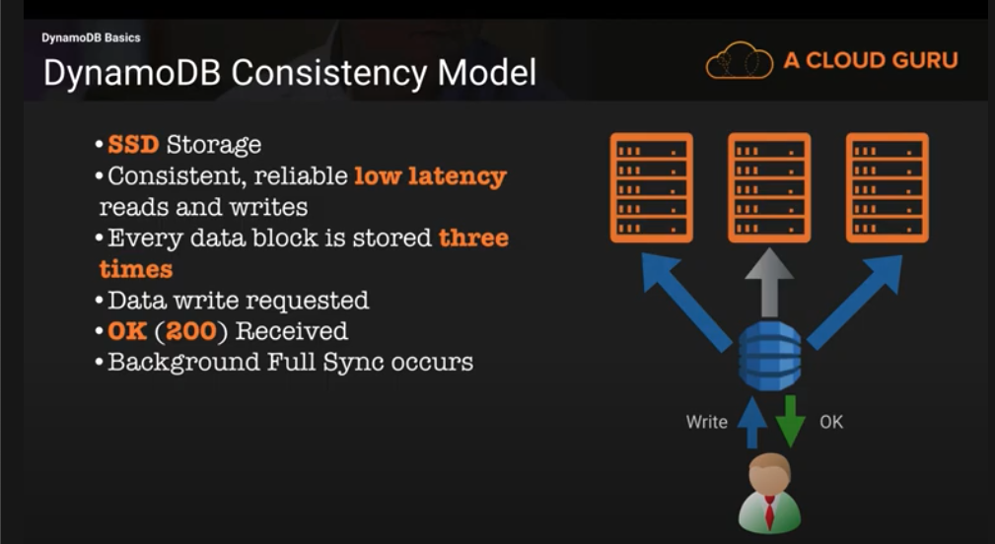
DynamoDB Consistency Model

Slide 10

Graph Databases
10 | Introduction to Databases (S20): Lecture 12 -- NoSQL

Slide 11
Graph Database
Exactly what it sounds like
Two core types
Node
Edge (link)
Nodes and Edges have
Label(s) = “Kind”
Properties (free form)
Query is of the form
p1(n)-p2(e)-p3(m)
n, m are nodes; e is an edge
p1, p2, p3 are predicates on labels
N->R->M

Slide 12
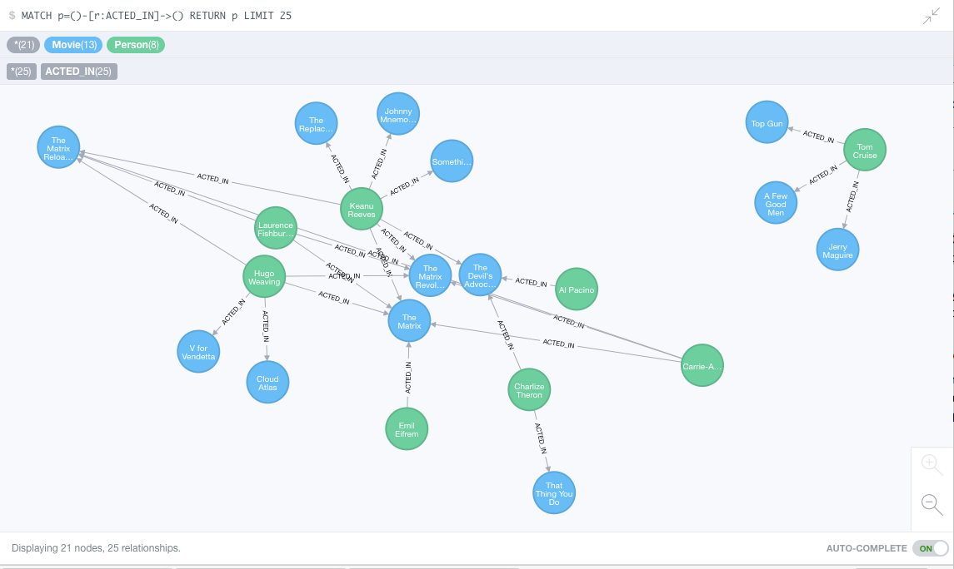
Neo4J Graph Query

Slide 13
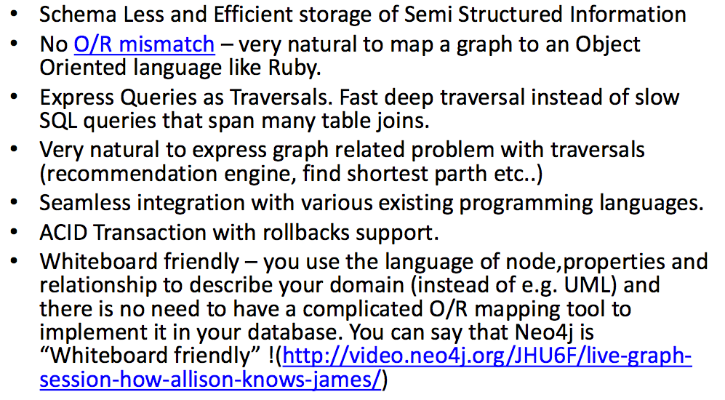
Why Graph Databases?

Slide 14
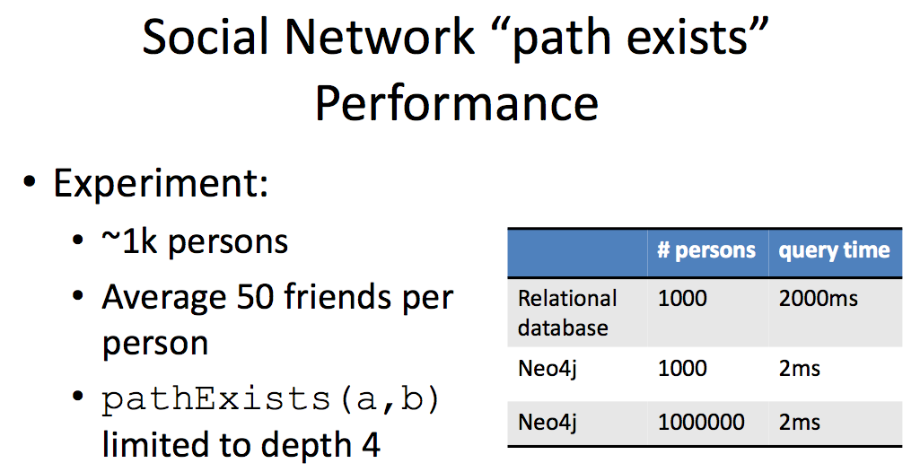
Graph databases are
Extremely fast for some queries and data models.
Implement a language that vastly simplifies writing queries.

Slide 15
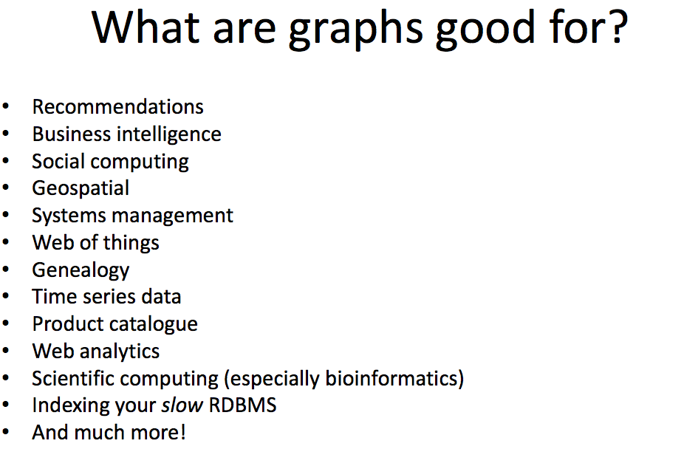

Slide 16
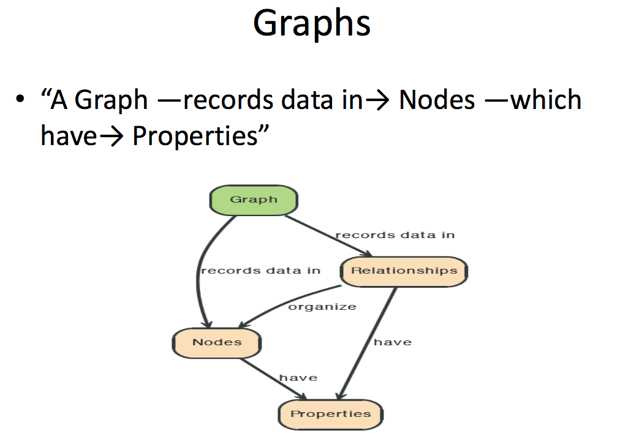

Slide 17
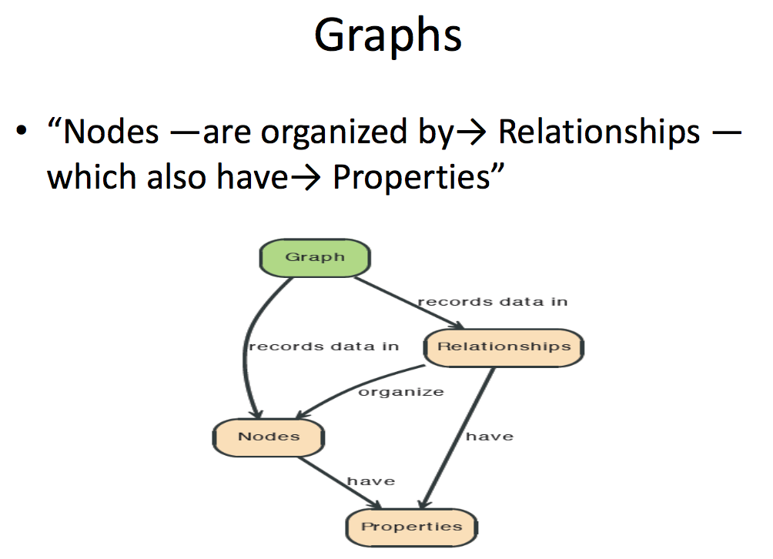

Slide 18
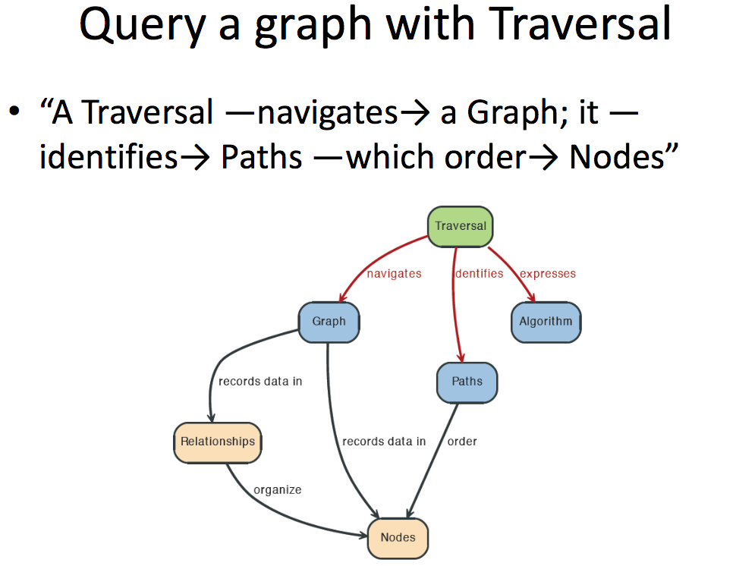

Slide 19
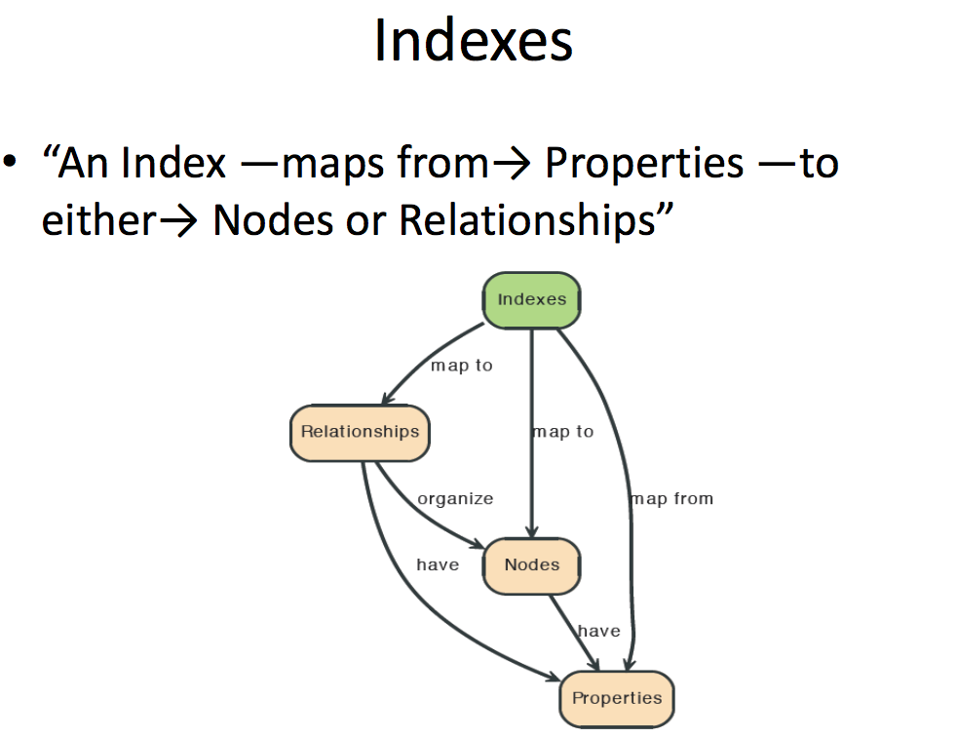

Slide 20
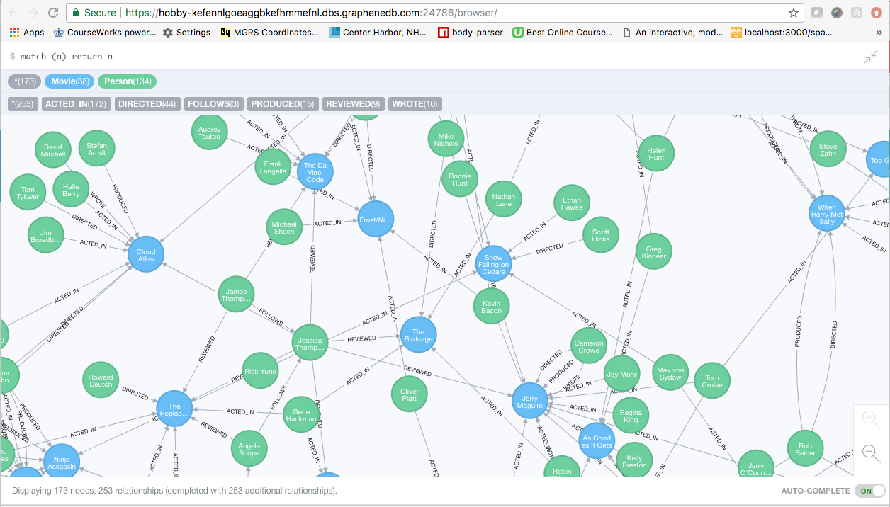
A Graph Database (Sample)

Slide 21
Neo4J Graph Query
Who acted in which movies?

Slide 22
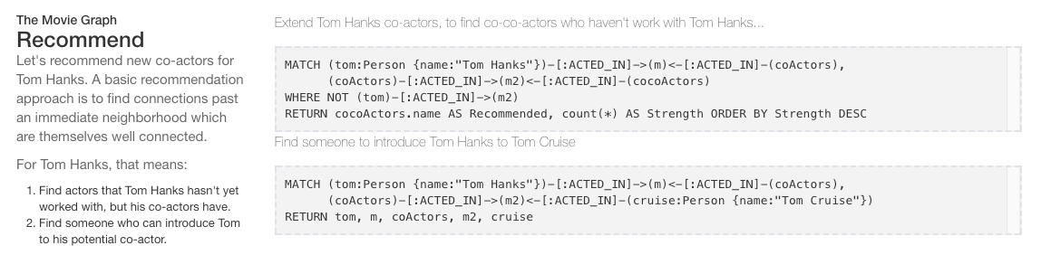
Big Deal. That is just a JOIN.
Yup. But that is simple.
Try writing the queries below in SQL.

Slide 23
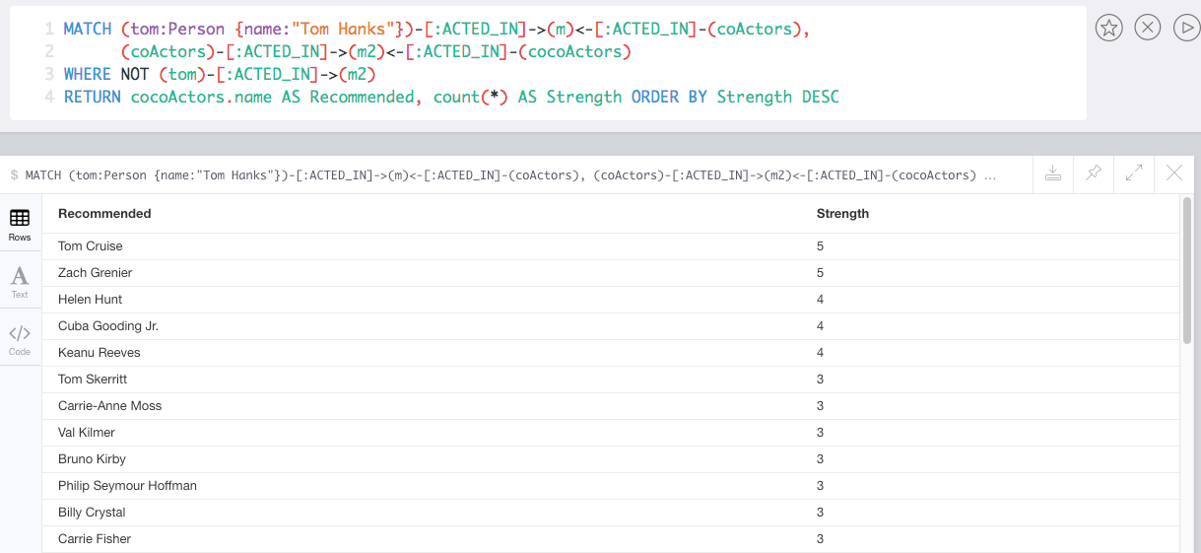
Recommend

Slide 24
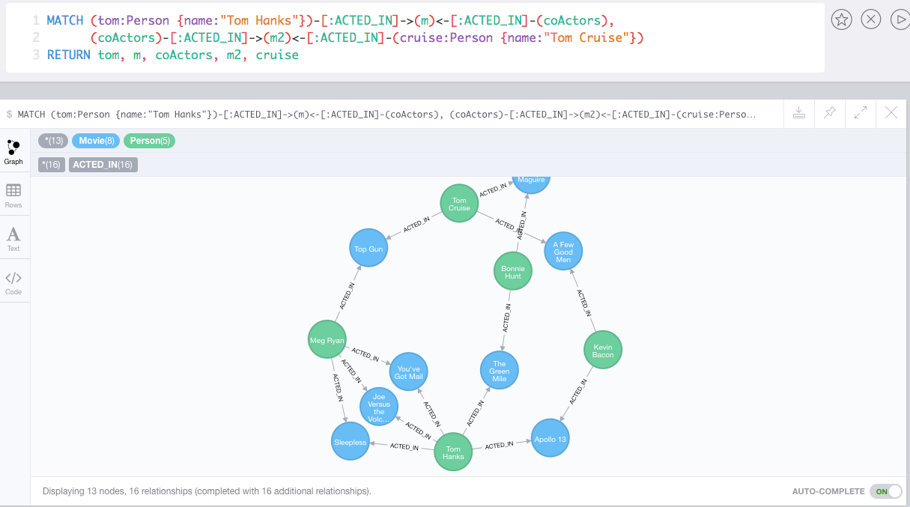
Which actors have worked with both Tom Hanks and
Tom Cruise?

Slide 25
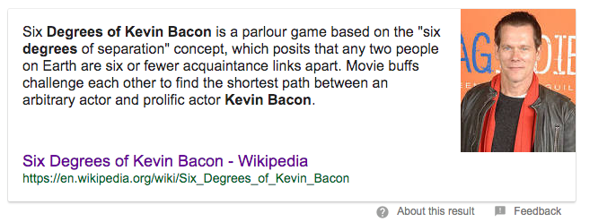
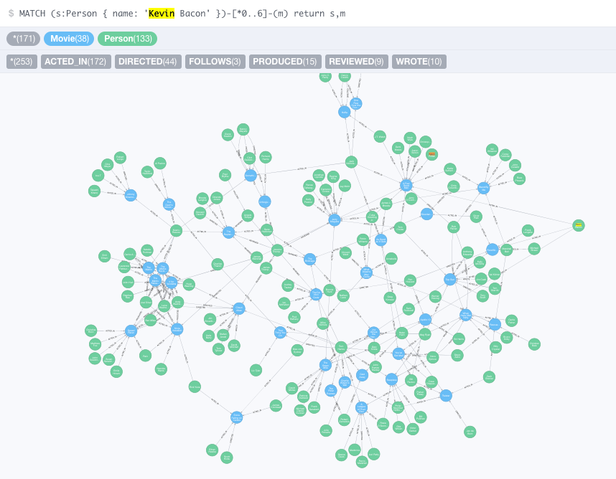
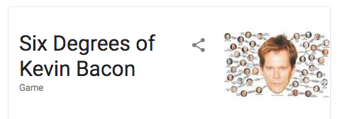

Slide 26
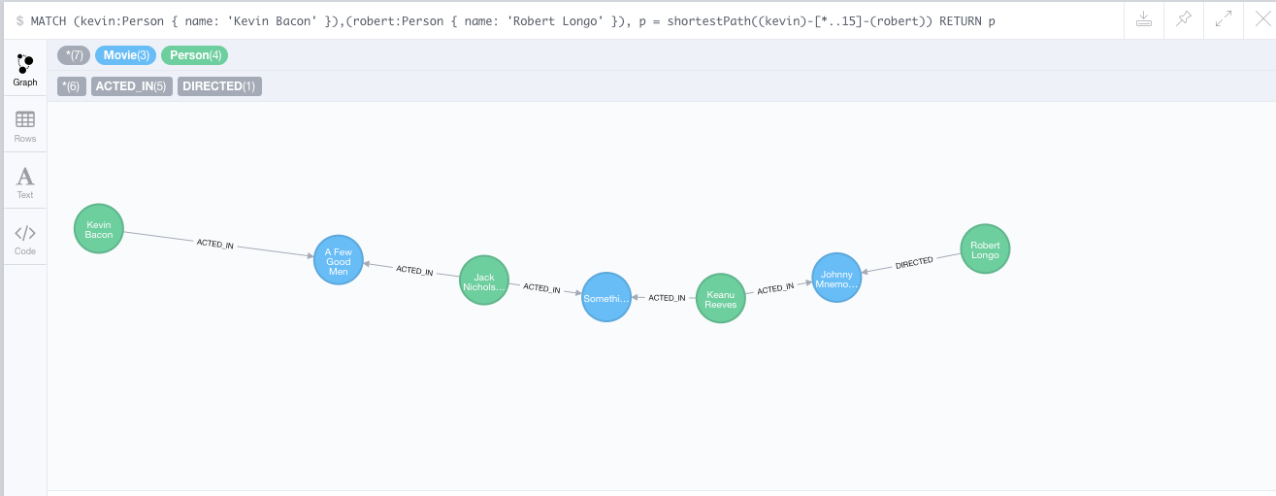
How do you get from Kevin Bacon to
Robert Longo?

Slide 27
Facebook Graph API
27 | Introduction to Databases (S20): Lecture 12 -- NoSQL

Slide 28
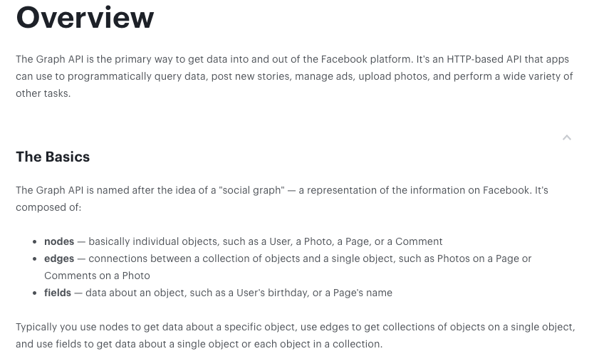
Facebook Graph API
https://developers.facebook.com/docs/graph-api/overview

Slide 29
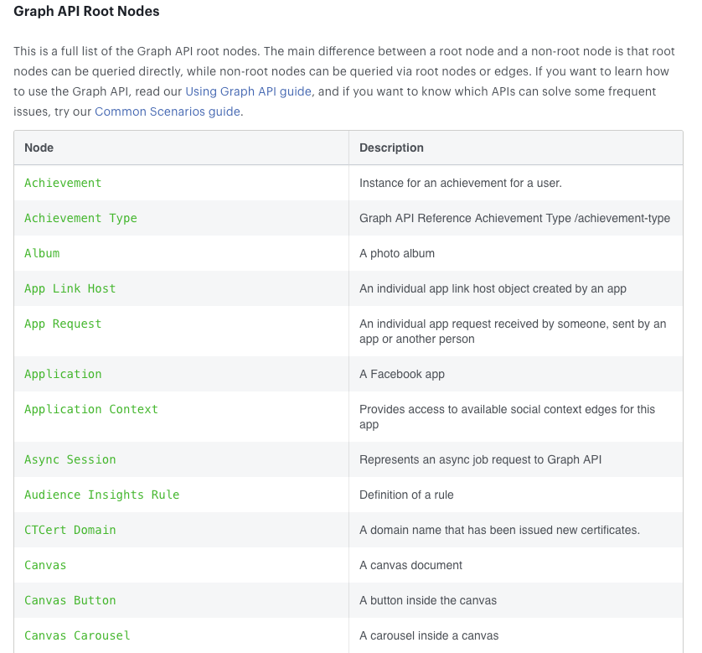
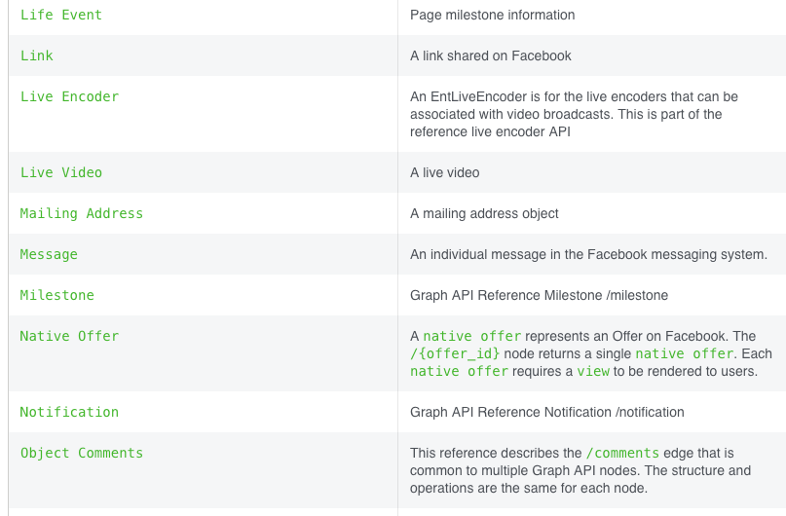
Facebook Graph API
Full list at:
https://developers.facebook.com/docs/graph-api/reference
… … …

Slide 30
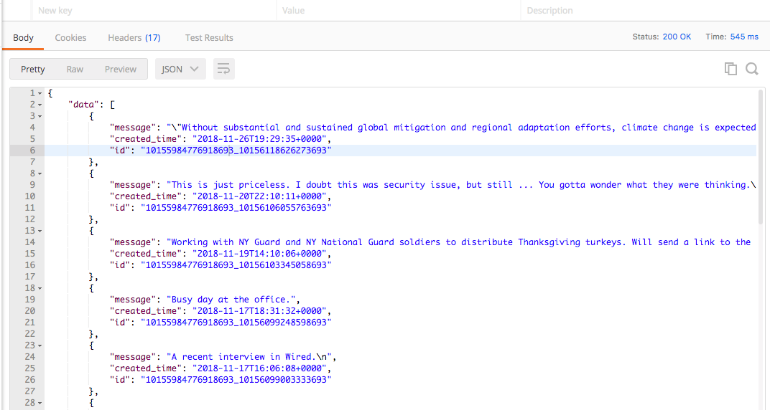
Facebook Graph API – Examples
https://graph.facebook.com/v3.2/me/posts?access_token=xxxxxxx

Slide 31
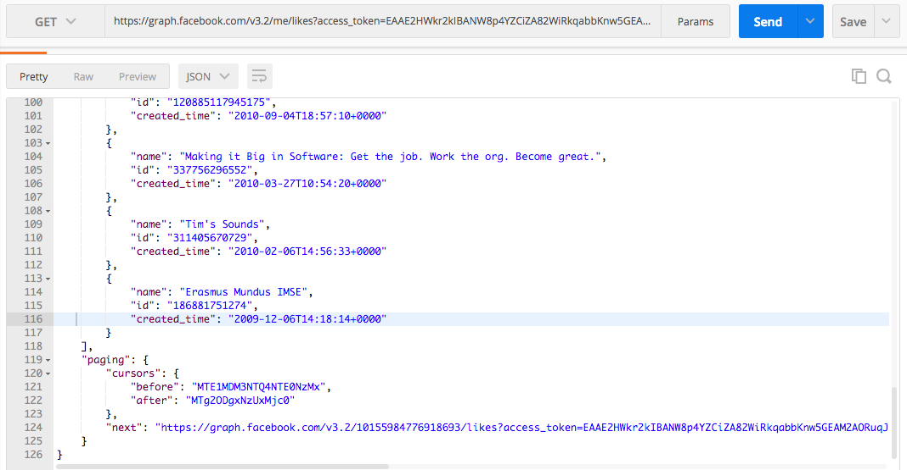
Facebook Graph API – Examples
https://graph.facebook.com/v3.2/me/likes?access_token=xxxxxxx
Notice use of paging links.

Slide 32
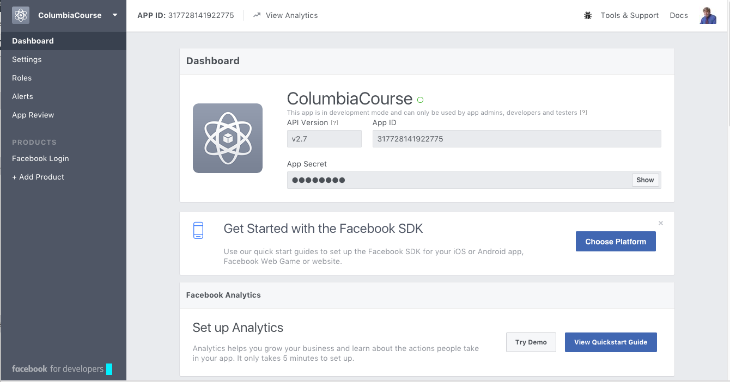
Facebook Applications
Facebook Application
Define an application at developers.facebook.com/apps/
Users log into your application via Facebook.
This grants your application permission to access the user’s Facebook content.
User must approve access on login and Facebook must “approve” the application for non-profile information.
Once logged onto your application via Facebook, you can
Get basic information about people.
Enable people to share, etc. information from your application to Facebook.
Perform analytics on users and their networks, subject to granted permissions.

Slide 33
Graph Database Summary
33 | Introduction to Databases (S20): Lecture 12 -- NoSQL

Slide 34
Graph Databases
Popularity and usage has exploded in the past few years.
Facebook Graph API (https://developers.facebook.com/docs/graph-api/)
LinkedIn (https://developer.linkedin.com/docs/rest-api)
Instagram (https://developers.facebook.com/docs/instagram-api)
Google Knowledge Graph (https://developers.google.com/knowledge-graph/)
Two major motivations:
Many common types of data are inherently graph oriented, and representing in RDB or some other mechanism results in icky code.
Performs of common graph operations is extremely slow in RDB.

Slide 35
Redis
35 | Introduction to Databases (S20): Lecture 12 -- No SQL

Slide 36



Redis
Redis Key-Value Database:
Practical Introduction
SoftUni Team
Technical Trainers
Software University
http://softuni.bg

Slide 37

Redis
Ultra-Fast Data Structure Server

Slide 38

What is Redis?
Redis is:
Ultra-fast in-memory key-value data store
Powerful data structure server
Open-source software: http://redis.io
Redis stores data structures:
Strings, lists, hashes, sets, sorted sets
Publish / subscribe messaging

Slide 39

Redis: Features
Redis is really fast
Non-blocking I/O, single threaded
100,000+ read / writes per second
Redis is not a database
It complements your existing data storage layer
E.g. StackOverflow uses Redis for data caching
For small labs Redis may replace entirely the database
Trade performance for durability → data is persisted immediately

Slide 40
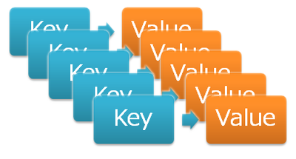
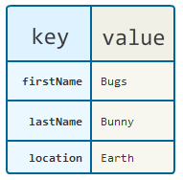
Redis: Data Model
Redis keeps key-value pairs
Every item is stored as key + value
Keys are unique identifiers
Values can be different data structures:
Strings (numbers are stored as strings)
Lists (of strings)
Hash tables: string → string
Sets / sorted sets (of strings)

Slide 41
Redis: Commands
Redis works as interpreter of commands:
SET name "Nakov"
OK
GET name
"Nakov"
DEL name
(integer) 1
GET name
(nil)
Play with the command-line client redis-cli
Or play with Redis online at http://try.redis.io

Slide 42
String Commands
SET [key] [value]
Assigns a string value in a key
GET [key] / MGET [keys]
Returns the value by key / keys
INCR [key] / DECR [key]
Increments / decrements a key
STRLEN [key]
Returns the length of a string
SET name "hi"
OK
GET name
"hi"
SET name abc
OK
GET "name"
"abc"
GET Name
(nil)
SET a 1234
OK
INCR a
(integer) 1235
GET a
"12345"
MGET a name
1) "1235"
2) "asdda"
STRLEN a
(integer) 4

Slide 43
Working with Keys
EXISTS [key]
Checks whether a key exists
TYPE [key]
Returns the type of a key
DEL [key]
Deletes a key
EXPIRE [key] [t]
Deletes a key after t seconds
SET count 5
OK
TYPE count
string
EXISTS count
(integer) 1
DEL count
(integer) 1
EXISTS count
(integer) 0
SET a 1234
OK
GET a
"1234"
EXPIRE a 5
(integer) 1
EXISTS a
(integer) 1
EXISTS a
(integer) 0

Slide 44
Working with Hashes (Hash Tables)
HSET [key] [field] [value]
Assigns a value for given field
HKEYS [key]
Returns the fields (keys) is in a hash
HGET [key] [field]
Returns a value by fields from a hash
HDEL [key] [field]
Deletes a fields from a hash
HSET user name "peter"
(integer) 1
HSET user age 23
(integer) 1
HKEYS user
1) "name"
2) "age"
HGET user age
"23"
HDEL user age
(integer) 1

Slide 45
Working with Lists
RPUSH / LPUSH [list] [value]
Appends / prepend an value to a list
LINDEX [list] [index]
Returns a value given index in a list
LLEN [list]
Returns the length of a list
LRANGE [list] [start] [count]
Returns a sub-list (range of values)
RPUSH names "peter"
(integer) 1
LPUSH names Nakov
(integer) 1
LINDEX names 0
"Nakov"
LLEN names
(integer) 2
LRANGE names 0 100
1) "Nakov"
2) "peter"

Slide 46
Working with Sets
SADD [set] [value]
Appends a value to a set
SMEMBERS [set]
Returns the values from a set
SREM [set] [value]
Deletes a value form a set
SCARD [set]
Returns the stack size (items count)
SADD users "peter"
(integer) 1
SADD users "peter"
(integer) 0
SADD users maria
(integer) 1
SMEMBERS users
1) "peter"
2) "maria"
SREM users maria
(integer) 1

Slide 47
Working with Sorted Sets
ZADD myzset 1 "one"
(integer) 1
ZADD myzset 1 "uno"
(integer) 1
ZADD myzset 2 "two" 3 "three"
(integer) 2
ZRANGE myzset 0 -1 WITHSCORES
1) "one"
2) "1"
…
Learn more at http://redis.io/commands#sorted_set

Slide 48
Publish / Subscribe Commands
First user subscribes to certain channel "news"
Another user sends messages to the same channel "news"
Learn more at http://redis.io/commands#pubsub
SUBSCRIBE news
1) "subscribe"
2) "news"
3) (integer) 1
PUBLISH news "hello"
(integer) 1

Slide 49
Using Redis as a Database
Special naming can help using Redis as database
Add a user "peter".
SADD users:names peter
HSET users:peter name "Peter Petrov"
HSET users:peter email "pp@gmail.com"
SADD users:names maria
HSET users:maria name "Maria Ivanova"
HSET users:maria email "maria@yahoo.com"
SMEMBERS users:names
HGETALL users:peter
Use "users:peter" as key to hold user data
Add a user "maria".
List all users
List all properties for user "peter"

Slide 50


Summary
Redis is ultra-fast in-memory data store
Not a database, used along with databases
Supports strings, numbers, lists, hashes, sets, sorted sets, publish / subscribe messaging
Used for caching / simple apps
Databases

Slide 51
Redis Common Usage

Slide 52
DynamoDB
52 | Introduction to Databases (S20): Lecture 12 -- No SQL

Slide 53
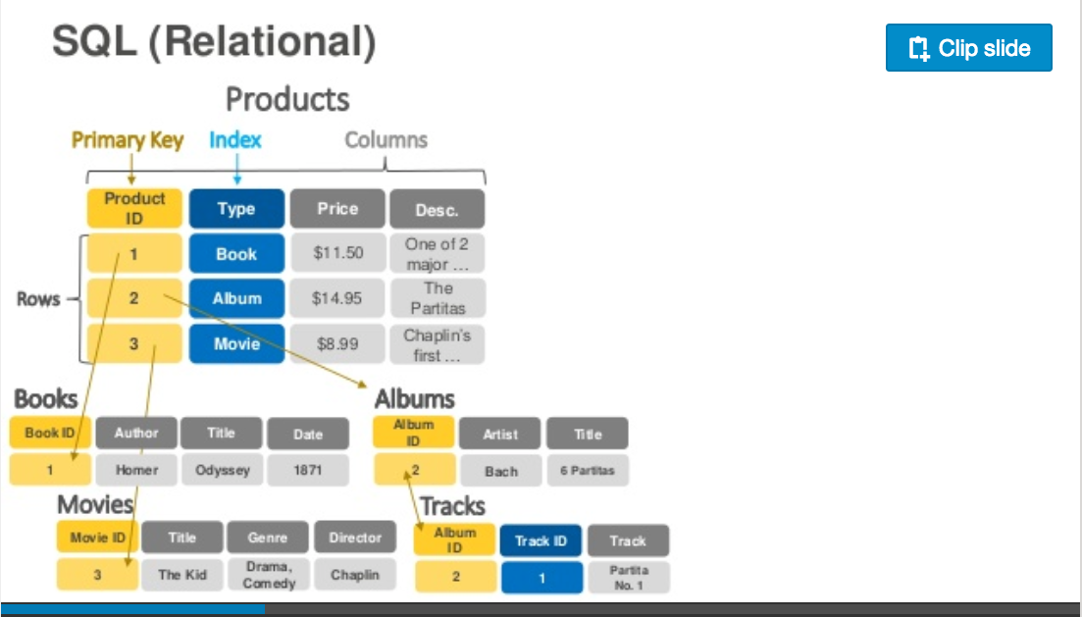
DynamoDB – Relational
https://www.slideshare.net/AmazonWebServices/introduction-to-amazon-dynamodb-73191648

Slide 54
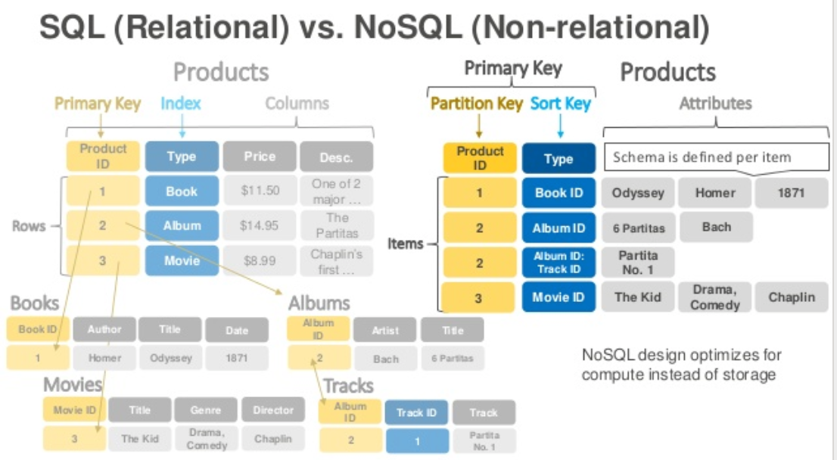
DynamoDB Data Model
Dynamo DB – Relational

Slide 55
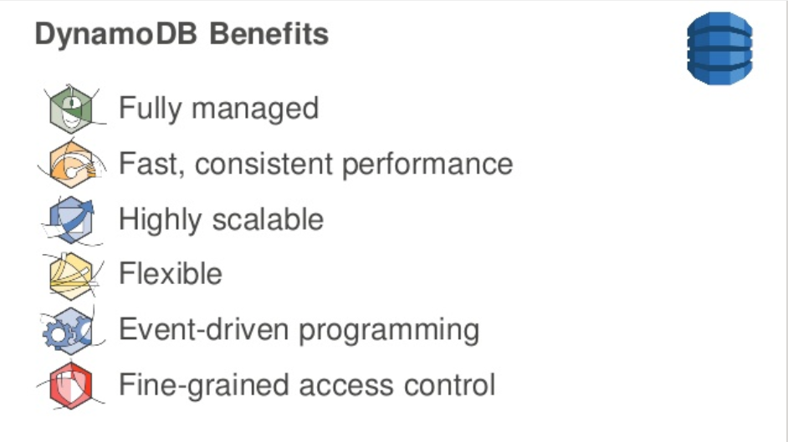
DynamoDB
DynamoDB Benefits

Slide 56
DynamoDB Hashing
DynamoDB – Hash Key

Slide 57
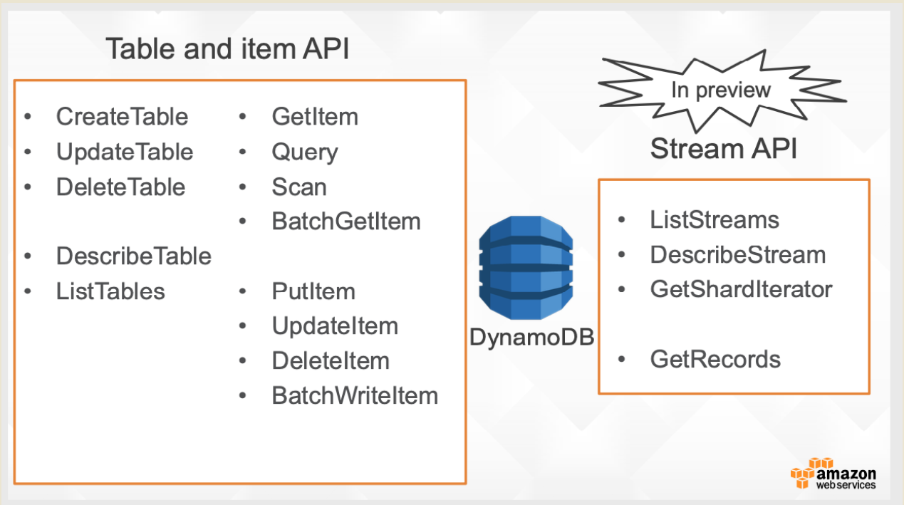
DynamoDB Model
57 | E6156: Topics in SW Engineering – Cloud Computing/BaaS

Slide 58
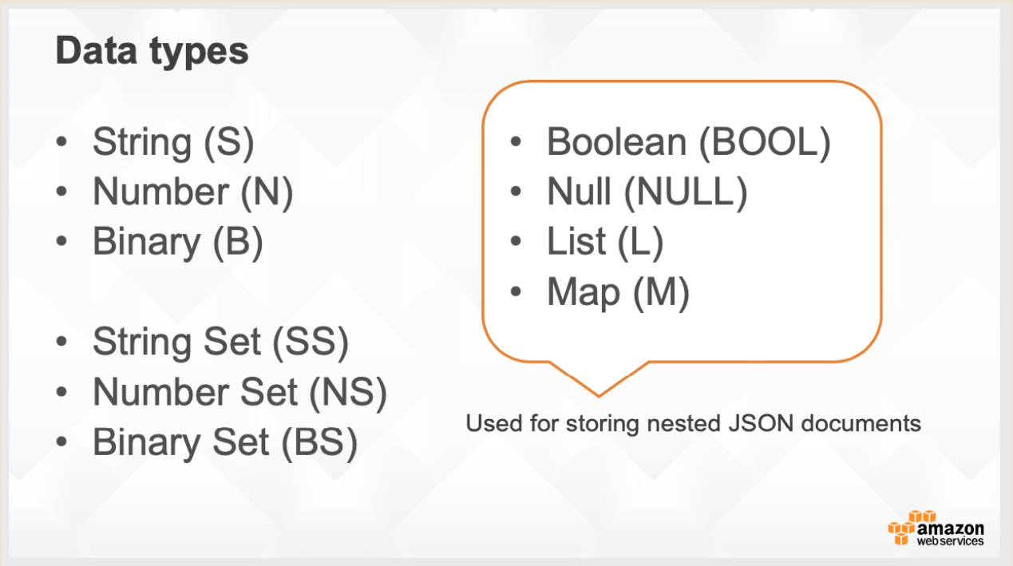
DynamoDB Model
58 | E6156: Topics in SW Engineering – Cloud Computing/BaaS

Slide 59
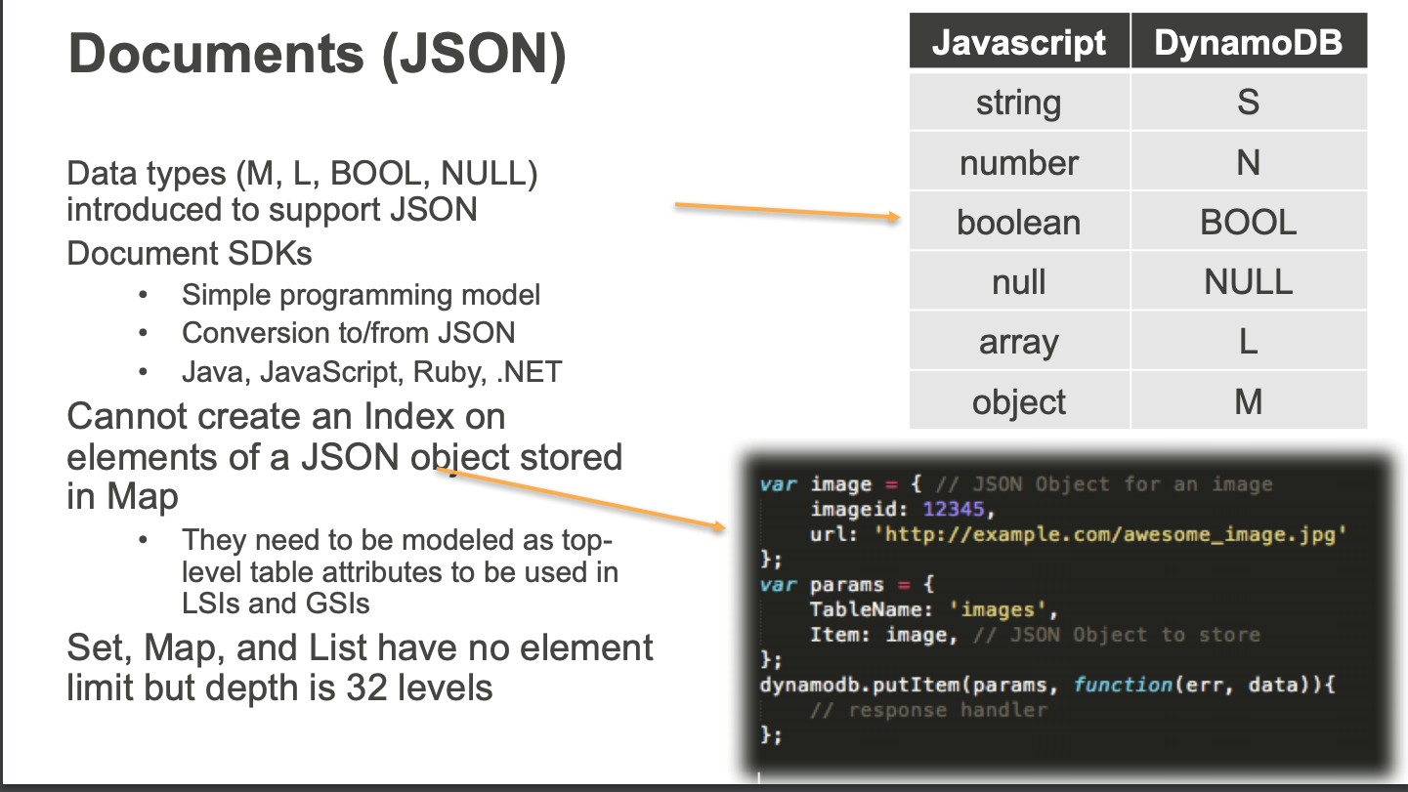
DynamoDB Model
59 | E6156: Topics in SW Engineering – Cloud Computing/BaaS

Slide 60
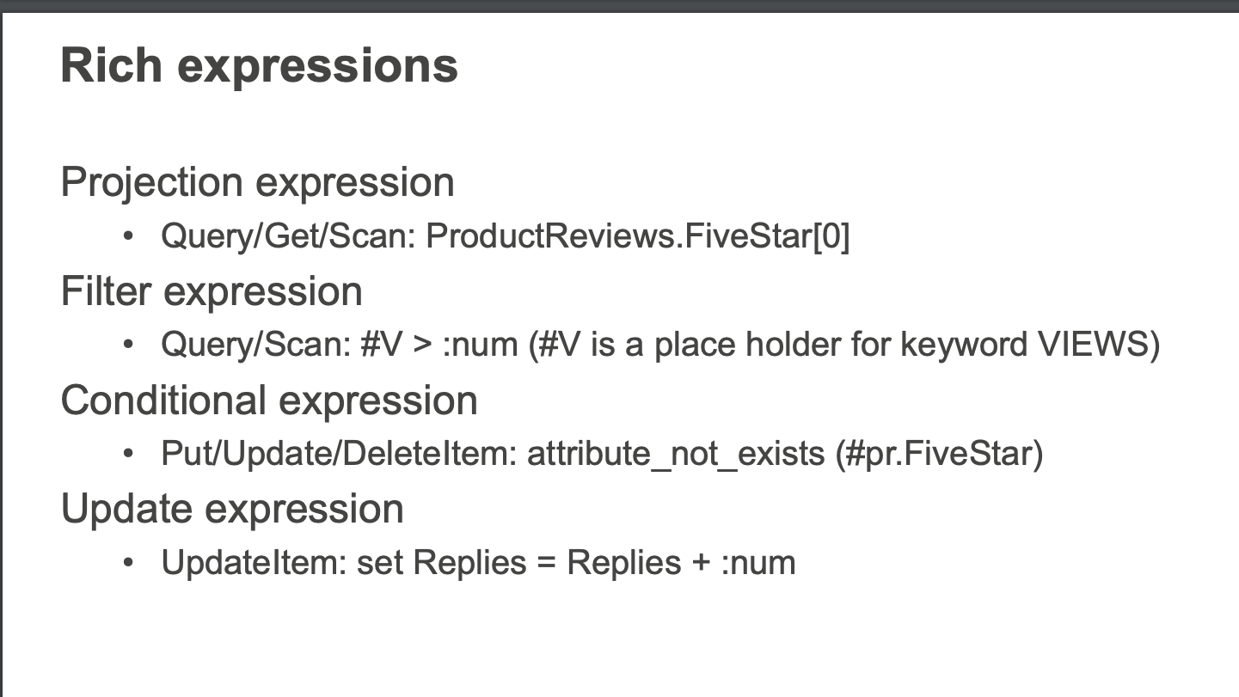
DynamoDB Model
60 | E6156: Topics in SW Engineering – Cloud Computing/BaaS

Slide 61
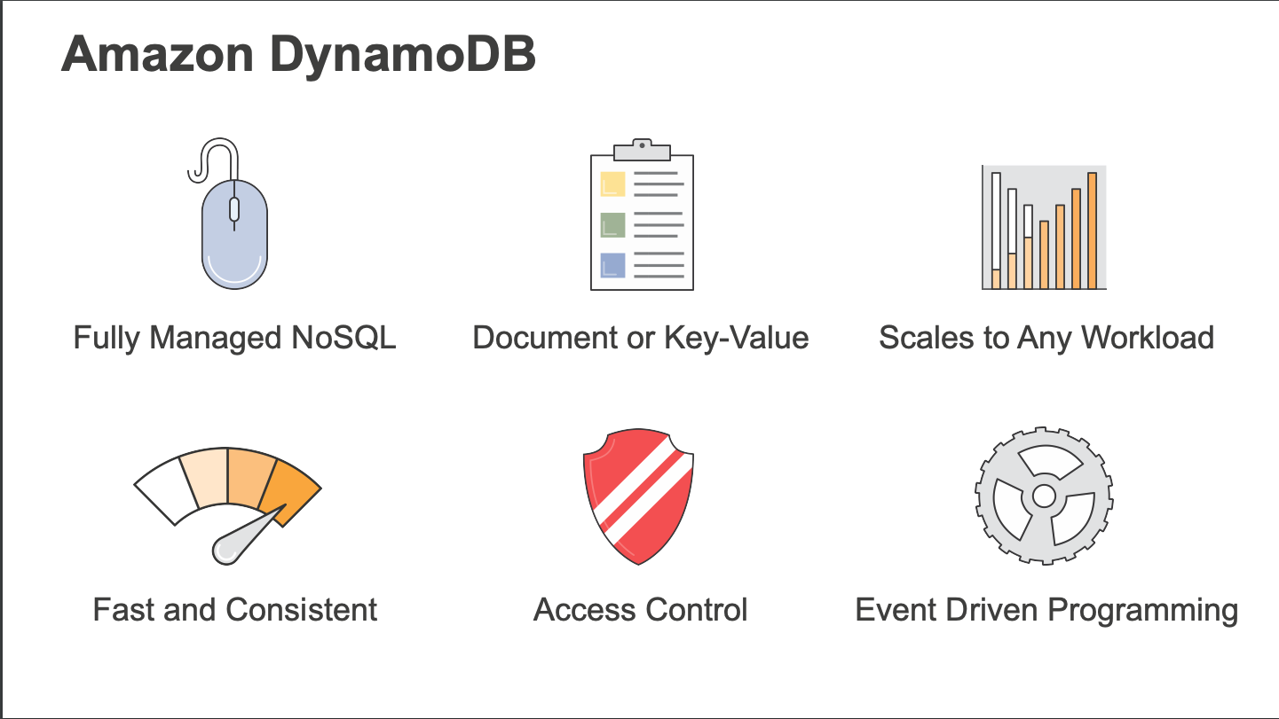
DynamoDB
61 | E6156 – Cloud Computing: Backend-as-a-Service (Lecture 6)

Slide 62
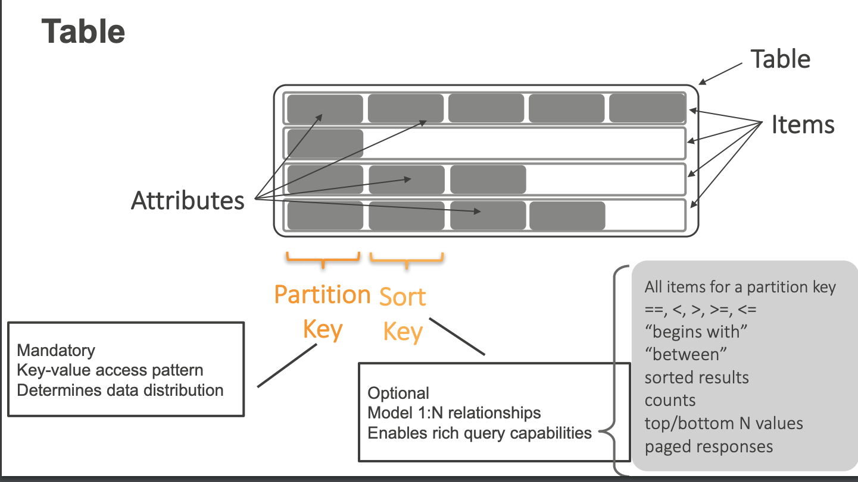
DynamoDB Model
62 | E6156: Topics in SW Engineering – Cloud Computing/BaaS

Slide 63
DynamoDB Model
63 | E6156: Topics in SW Engineering – Cloud Computing/BaaS

Slide 64
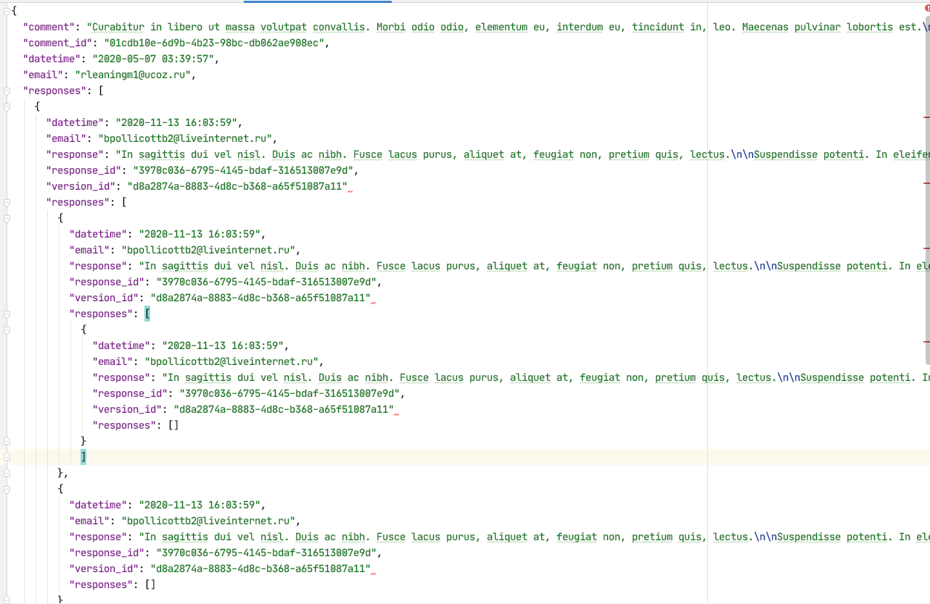
Document Databases – Semi-Structured Schema
The relation model has difficulties with some types of data:
Columns that are lists or maps
Nesting – things inside things
Discover you need a modified schema when you get a piece of data.
etc.
All of these are common for documented like data:
Threaded discussions.
Documents.
... ...
Document DBs emerged to handle these scenarios.
64 | E6156: Topics in SW Engineering – Cloud Computing/BaaS

Slide 65
DynamoDB Model
65 | E6156: Topics in SW Engineering – Cloud Computing/BaaS

Slide 66
DynamoDB Model
66 | E6156: Topics in SW Engineering – Cloud Computing/BaaS

Slide 67
DynamoDB Model
67 | E6156: Topics in SW Engineering – Cloud Computing/BaaS

Slide 68
DynamoDB Model
These become interesting when we look at ETags and conditional updates in REST.
68 | E6156: Topics in SW Engineering – Cloud Computing/BaaS

Slide 69
Approaches to Scalability
Scale Up – Scale Out

Slide 70
Scale Up – Scale Out
Capacity
Request Load

Slide 71
Scale Up – Scale Out
Price
Powerful

Slide 72
Data Sharing and Scaling

Slide 73
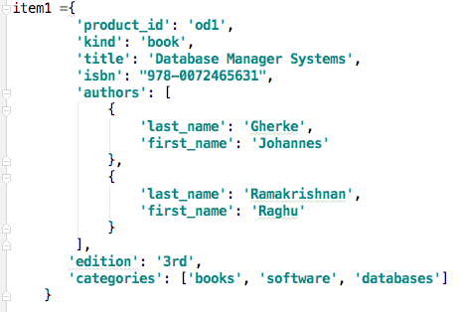
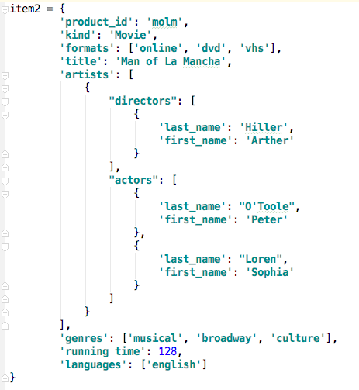
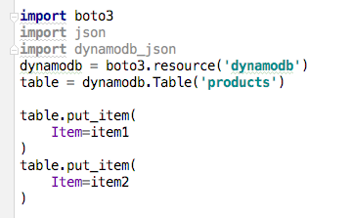
DynamoDB API

Slide 74
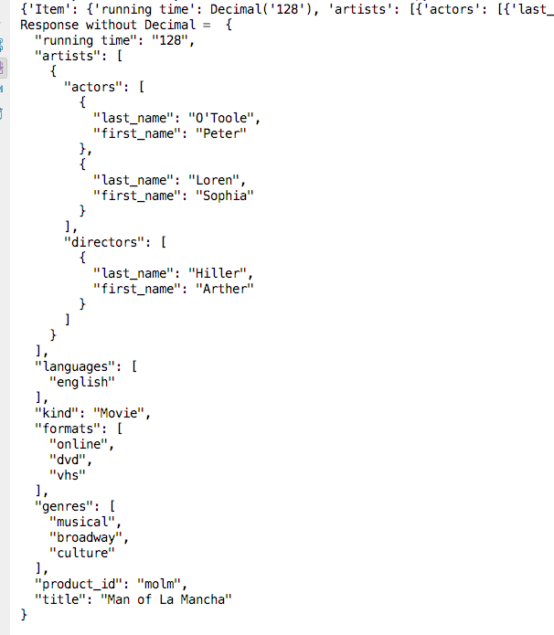
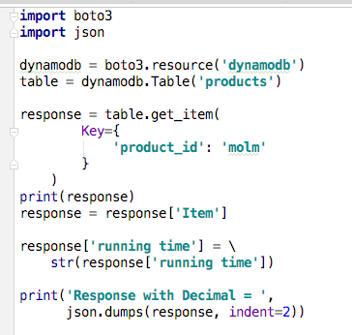
DynamoDB

Slide 75
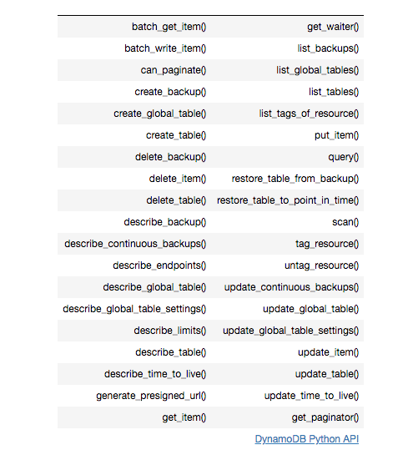
DynamoDB Summary
Achieves much greater scalability and performance than RDBMs
Does not support some RDBMs capabilities:
Referential integrity.
JOIN
Queries limited to key fields.
Non-key field queries are always scans.
Data model better fit for semi-structured data models and good fit for JSON
Maps
Lists

